Slide 1
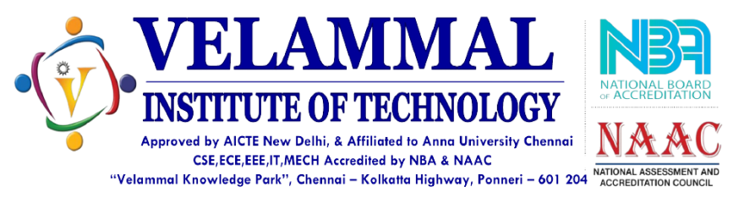
DEPARTMENT OF INFORMATION TECHNOLOGY
IoT based Dustbin management System .
DOMAIN:INTERNET OF THINGS
PRESENTED BY(Batch no:05)
1 . AJAY M (113320205002)
2 . DHANUSH M (113320205009)
3 . KAVIBHARATHI A (113320205019)
GUIDE NAME:
Ms. C. CATHRIN DEBORAL M.Tech AP/IT

Slide 2
ABSTRACT
The scenario of cleanliness with respect to garbage management is degrading tremendously.
The overflow of garbage in public areas creates the unhygienic condition in the nearby surrounding. It may provoke several serious diseases amongst the nearby people. It also degrades the valuation of the area.
To avoid this and to enhance the cleaning, ‘Dustbin management system’ is proposed in this project.
In the proposed system, the wet waste will detected and the level of garbage in the dustbins is detected with the help of Sensor systems

Slide 3
INTRODUCTION
Due to rapid population growth, disorganization of city governments, a lack of public awareness and limited funding for programs waste management is become a global problem. The Central Public Health and Environmental Engineering Organization (CPHEEO) has estimated that waste generation in India is as much as 1.3 per day.
So we built the project ‘Dustbin Management system’ to reduce the global problems which is caused by garbage waste

Slide 4
AIM
To detect the wet content waste in the dustbin and notify to maintenance office by using GSM.
To maintain the cleanliness in the city and form an environment which is better for living.

Slide 5
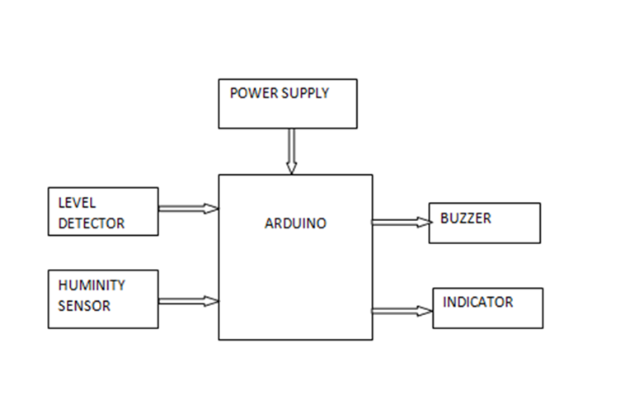
BLOCK DIAGRAM
CAPACITIVE
The main blocks of this block diagram are:
• Power system
• Sensors
• Arduino Uno microcontroller

Slide 6
EXISTING SYSTEM
The proposed system is implemented with the help of IoT technology equipped with Arduino and other sensors. The system connected with IR sensor, moisture sensor.
The proposed system is implemented and tested with the sample waste materials. The system segregates the materials successfully with higher accuracy.
The sensor output is displayed in LCD and the respective data is uploaded into the server.
The proposed system efficiently classifies the waste and segregates and dumps into their respective bins.

Slide 7
PROPOSED SYSTEM
Design of hardware prototype to indicate level of garbage in the garbage bins
At each location, two garbage bins (for wet and dry garbage) are placed which contain ultrasonic sensors to indicate level of garbage in the bin
In this project work, a microcontroller based monitoring gad jets is built & placed in every dust bin. The gadgets at the dust bin will be interfaced with sensors to monitor weight of the dust bin, to monitor whether dust bin is filled or not & to sense hazarders bio degraders.

Slide 8
If a person throws wet waste , the buzzer will start ring and passing a message(at what time and which waste was threw)to the maintenance officer’s system.
Click this link http://iotwebdata.com/table.php?id=5q3efs8f
to see the message.
Once any of this sensor alarms the critical conditions like over weights, overflow or biodegradation, the microcontroller unit.

Slide 9
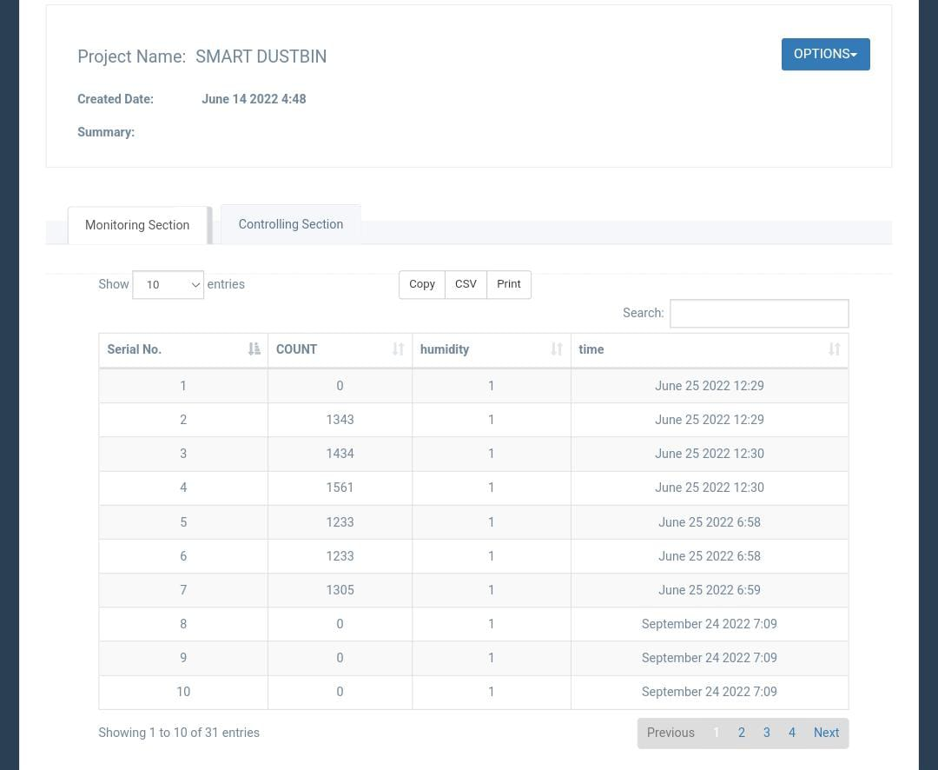
MESSAGE OUTPUT

Slide 10
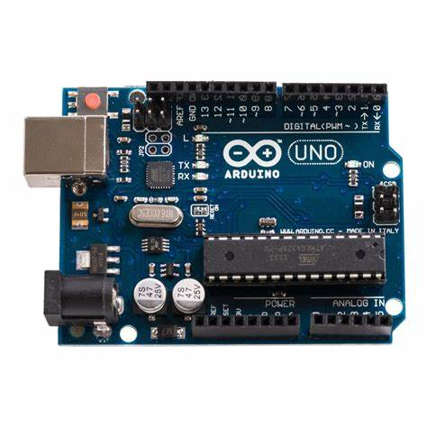
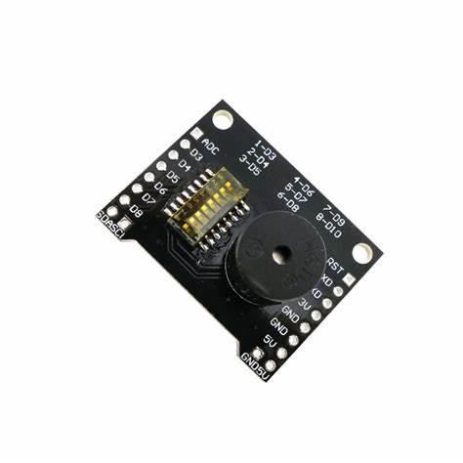
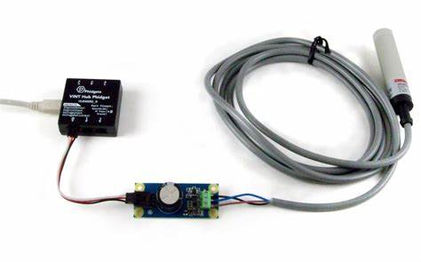
HARDWARE REQUIRNMENTS
2. BUZZER.
1. ARDUINO UNO MICROCONTROLLER.
OTHER COMPONENTS:
4. INDICATOR.
5. LEVEL DETECTOR.
6. POWER SUPPLY.
3. CAPACITIVE SENSOR.

Slide 11
LITERATURE SURVEY
TITLE:IoT Based Smart Waste Management System: India prospective”
YEAR: 2019
DESCRIPTION:For building smart cities there is requirement of such a smart system which monitors the dustbin and provides its real time status. In present scenario Municipal Corporations in India doesn’t get real time information about the dustbins. In this concern, we are implementing a system based on Internet of Things (IoT) that can send a message to corporation about the overflow and toxicity level of the dustbins. A website is also developed to supervise the data related to the dustbins. Message is sent using GSM module to the mobile phone and data related to the dustbin status is updated on the website. At this website citizens can also submit complaints related to dustbin or waste management. In recommended system, Arduino is used as a microcontroller to interface between GSM/GPRS module with sensors. Ultrasonic sensor and gas sensor are used for measurement of dustbin level and toxicity respectively.

Slide 12
TITLE:“IoT Based Smart Waste Management System”
YEAR: 2021
DESCRIPTION: Nowadays, wasting food is common among the students in colleges, hostels, and workplaces. This results in a great demand for food products in the future, which may lead to food scarcity for future generations. As food waste management is tedious process. In this paper we have mainly focused on measuring the food waste and providing rewards for the users, where it shows the real-time food wastage of every individual on a screen and in a website for future reference. This research mainly focuses on monitoring the food wastage of everyone. Our model proposed over and create a parallel result to give a detailed report to the managing and the user about their amount of food excess each time. This helps to analyze and generate the list of user falls under the non-food wasting criteria and reward them for their noble act. We can do this either manually or automating the process using Internet of Things as a key tool. We use an RFID sensor to monitor the wastage of individuals. They can be opened only by using the RFID card provided by the management.

Slide 13
TITLE: “IoT-based Intelligent Waste Bin”
YEAR: 2018
DESCRIPTION:The amount of the waste humans discards is rapidly increasing and will not be controlled without transformational changes. Waste management companies will be hugely impacted with such increments as they should provide resources for the collection of such waste with minimum or even zero income. This project aims to develop smart real-time waste management and monitoring system that optimized the resources and maximized the efficiency. The system is designed based on three main elements; Master station, Slave station, and Internet of things (IoT) platform. The master pin station gathers the data from the slave stations and transmits it to the IoT application for remote management and monitoring purposes. The system is powered up by using solar panels. Four parameters are used for monitoring and managing the waste: temperature value, level in percentage reading, smoke detection, and the global positioning system (GPS) location. The development phase of the system is designed into two phases; system modeling and hardware implementation. This paper present the modeling phase of the system development.

Slide 14
TITLE: “IoT Based Solution for Waste Management: A Review”
YEAR: 2020
DESCRIPTION:Careless throwing of waste material onto the roads is a common scenario to be found in our day to day life, this leads to an unhygienic environment around us. As garbage on the roads and public places are increasing day by day this can result in different type of diseases and standard of living will be degraded in future. Thus to overcome these problems some efficient system should be developed using IOT as its scope is increasing day by day. Various methods and design are available at present having both advantages and disadvantages. This paper provides a summarization of various applications of IOT solutions and technologies used in the field of Public Welfare and Hygiene.

Slide 15
TITLE: “IoT based Smart Waste Bin to Track Dustbin and Public Complaint Management System”
YEAR: 2018
DESCRIPTION: Internet or net of effects is concerned in every one parts of human life, work, health and social zones, which will importantly affect the prospect development of the worldwide financial society. Internet of Things (IoT) permits association among gadgets utilizing web with the capacity to accumulate and trade data. The net of objects refers to a kind of n/w to link everything with the net based on specific protocols during info sensing tools to perform info substitute &communications in order to complete smart recognitions, positioning, tracing, monitoring, and administration. Recent scientific advance have led to an increase in the carbon footprint. Energy efficiency in the IoT has been magnetize a lot of thought as of researchers & designers above the last pair of years, concrete the way for an emerging area called green IoT

Slide 16
CONCLUSION
The wet waste detection system in a dustbin using IoT is an innovative solution that can help in efficient waste management. By using sensors and IoT technology, the system can accurately detect the level of wet waste in the dustbin and send alerts to the concerned authorities for timely disposal.
The system has several benefits, including reduced manual labor, cost effectiveness, and improved hygiene.
However, the system also has some limitations, such as the need for a stable power supply and the possibility of false readings due to external factors like temperature and humidity. These limitations need to be addressed during the design and implementation of the system.

Slide 17
REFERENCES
[1] Rishabh Kumar Singhvi, Roshan Lal Lohar, Ashok Kumar, Ranjeet Sharma, Lakhan Dev Sharma, Ritesh Kumar Saraswat.
TITLE: IoT Based Smart Waste Management System: India prospective”
YEAR: 2019
[2] Gayathri N,Divagaran A R, Akhilesh C D, Aswin V M, Charan N
TITLE: “IOT Based Smart Waste Management System”
YEAR: 2021
[3] Moath Awawdeh, Anees Bashir, Tarig Faisal, Irfan Ahmad, and Muhammad Khalil Shahid
TITLE: “IoT-based Intelligent Waste Bin”
YEAR: 2018

Slide 18
[4] Deepti Agarwal, Prateek Chaudhary, Vidhushi Jain, Piyush Sachan, Ritik Gupta
TITLE: “IOT Based Solution for Waste Management: A Review”
YEAR: 2020
[5] Ajmal Khan, Sandeep Kumar Agarwal
TITLE: “IOT based Smart Waste Bin to Track Dustbin and Public Complaint Management System”
YEAR:2018
[6] R. Priyadharshini and S. Vijayalakshmi
TITLE: "Smart Waste Management System Using IoT“
YEAR: 2019

Slide 19
THANK YOU

